Slide 1
Predicting Failure: Part IV
Presented by:
Ashley Darnell, Ethan Hawk, Joshua Nibbe

Slide 2
Purpose
Project Purpose:
Predict failure as a binary variable
Combine the knowledge learned from past research with our own to get a holistic model for predicting student failure.
Why:
Academic achievement is often thought of as a student-only burden
Intelligence is not the only driving force behind grades
Want to prove that there are many outside elements that influence a students academic performance

Slide 3
Data
Data:
UCI Machine Learning Repository
The data was collected from 649 students of a Portuguese high school over one year.
It consists of 33 variables with 17 categorical and 16 numerical.
Imbalanced
The variable failures was skewed towards 0, this was coded as binary 0 - no failures and 1- failures to alleviate some of the imbalance.

Slide 4
Feature Selection
Heat map with all variables
Threshold of .11 was chosen as the value for a significance level of predictors.
Threshold determined due to the fact that anything higher would leave out almost all variables.
Predictors
10 predictors left after elimination
Age, Medu, Fedu, Traveltime, studytime, Dalc, absences, G1, G2, & G3

Slide 5
Methods
Model Evaluation
Avg cross validation recall score is the metric that will be the focus of model evaluation
This allows us to see how many cases of failure the models predicted.
Recall is especially useful for us because of the imbalance in our data set.
SMOTE
We ran each model first on its own and then using SMOTE resampling to see if we could improve the scores
For each model we examined a confusion matrix, ROC AUC curve, and other evaluation metrics.
Logistic regression
The logistic regression model predictors were chosen from running a chi-square test and taking all of the significant variables
Guardian, Higher

Slide 6
Results of the Project
Best results
The model that best predicted failures according to the average cross validation recall score was the Random Forest with SMOTE resampling.
Not only did this model produce a great recall, it also produced good accuracy, precision, F1, and ROC curve scores.
 | CV Recall | Accuracy | Precision | F1 | ROC Curve
RF w/ SMOTE | .94 | .75 | .87 | .78 | .88

Slide 7
Results From All Models
 | Recall Score | Avg. Recall from Cross Validation | ROC Score
Decision Tree | .76 | .41 | .79
DT w/ SMOTE | .82 | .30 | .86
Random Forest | .78 | .31 | .85
Random Forest w/ SMOTE | .72 | .94 | .86
Logistic Regression | .85 | .87 | .87
LR w/ SMOTE | .61 | .86 | .82

Slide 8
Avoiding Multicollinearity
Multicollinearity
Results must be taken with a grain of salt due to the multicollinearity in G1, G2, & G3
To address this we want to do an interaction term or eliminate one of these predictors
More on avoiding multicollinearity in predictors
Examine a heat map & remove predictors that correlate with each other too highly (over .9)
Perform a least squares regression with remaining variables
Eliminate columns using backwards regression until all are significant to 95% confidence
Remaining columns are the predictors

Slide 9
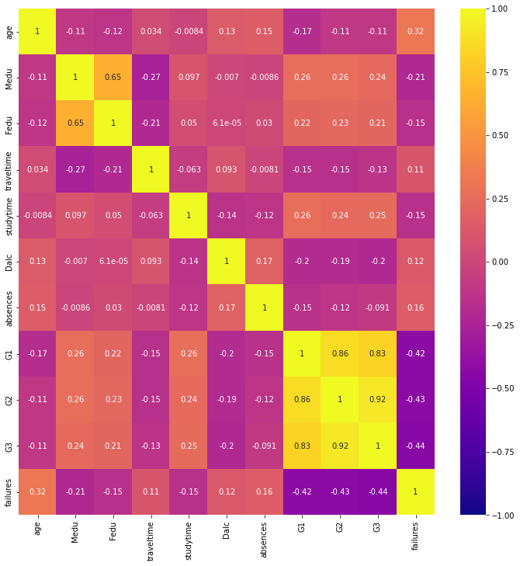
Heatmap for Correlation

Slide 10
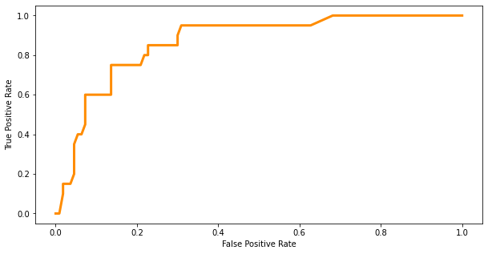
ROC curve for Random Forest w SMOTE
ROC AUC = .867

Slide 11
Difficulties
Feature Selection
How?
The most difficult part was determining the best way to pick predictors for models
Metrics
What?
Determining what makes which of our models the “best” one, once we had made them
Organization
Where?
Determining how to organize the colab notebook as well as the paper to make logical sense

Slide 12
Works Cited
https://towardsdatascience.com/feature-selection-correlation-and-p-value-da8921bfb3cf

Slide 13
Any Questions?
???

